Slide 1
INTRODUCTION TO
ALGORITHMS
FOURTH EDITION

Slide 2
LECTURE NOTES FOR CHAPTER 3
Characterizing Running Times

Slide 3
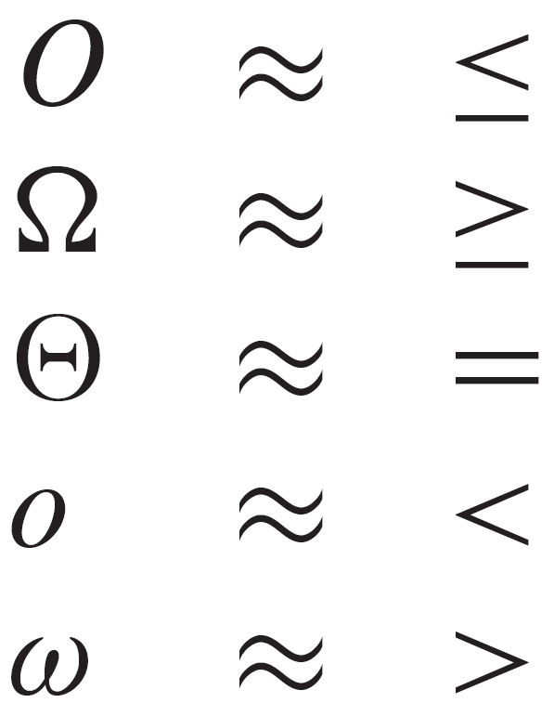
CHAPTER 3 OVERVIEW
Goals
A way to describe behavior of functions in the limit. We’re studying asymptotic efficiency.
Describe growth of functions.
Focus on what’s important by abstracting away low-order terms and constant factors.
How we indicate running times of algorithms.
A way to compare “sizes” of functions:

Slide 4
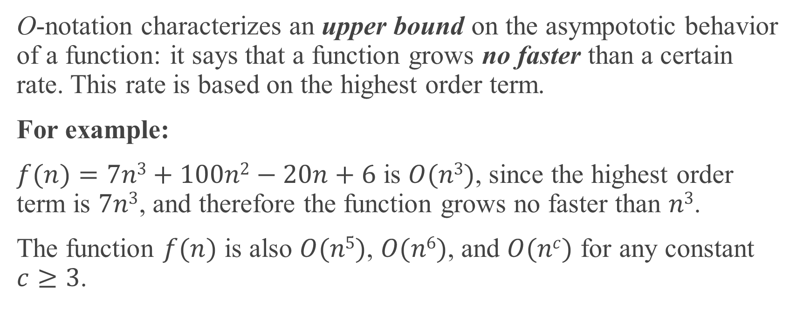
O-notation
O-notation characterizes an upper bound on the asympototic behavior of a function: it says that a function grows no faster than a certain rate. This rate is based on the highest order term.
For example:
$f(n)=7n3+100n2−20n+6$ is $O(n3)$, since the highest order term is $7n3$, and therefore the function grows no faster than $n3$.
The function $f(n)$ is also $O(n5)$, $O(n6)$, and $O(nc)$ for any constant $c≥3$.

Slide 5
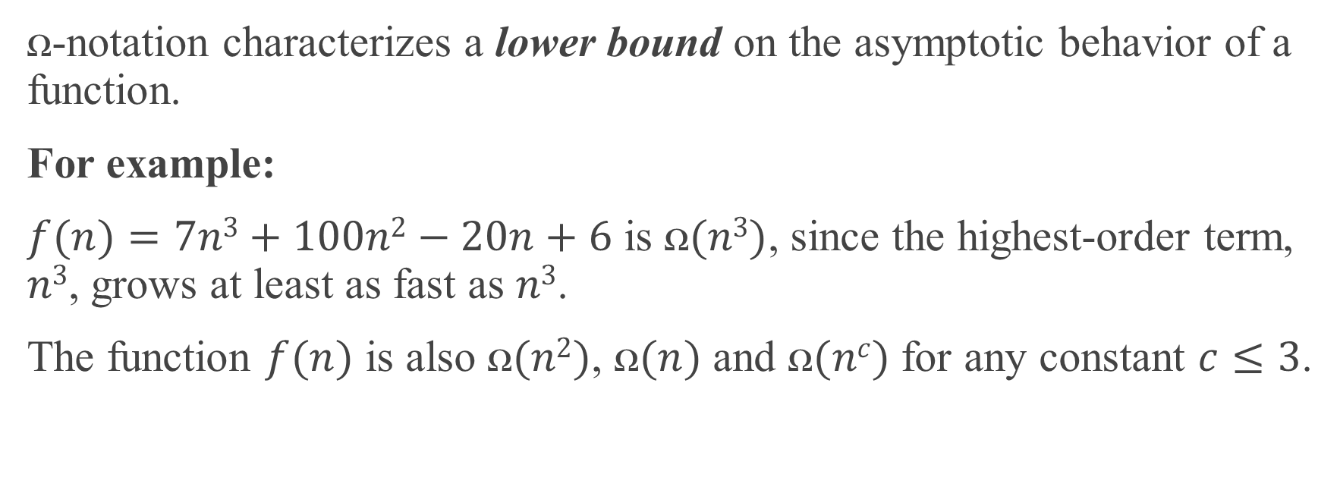
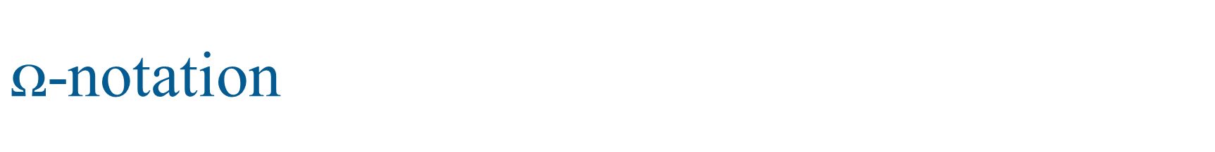
$ꭥ$-notation
ꭥ-notation characterizes a lower bound on the asymptotic behavior of a function.
For example:
$f(n)=7n3+100n2−20n+6$ is $ꭥ(n3)$, since the highest-order term, $n3$, grows at least as fast as $n3$.
The function $f(n)$ is also $ꭥ(n2)$, $ꭥ(n)$ and $ꭥ(nc)$ for any constant $c≤3$.

Slide 6
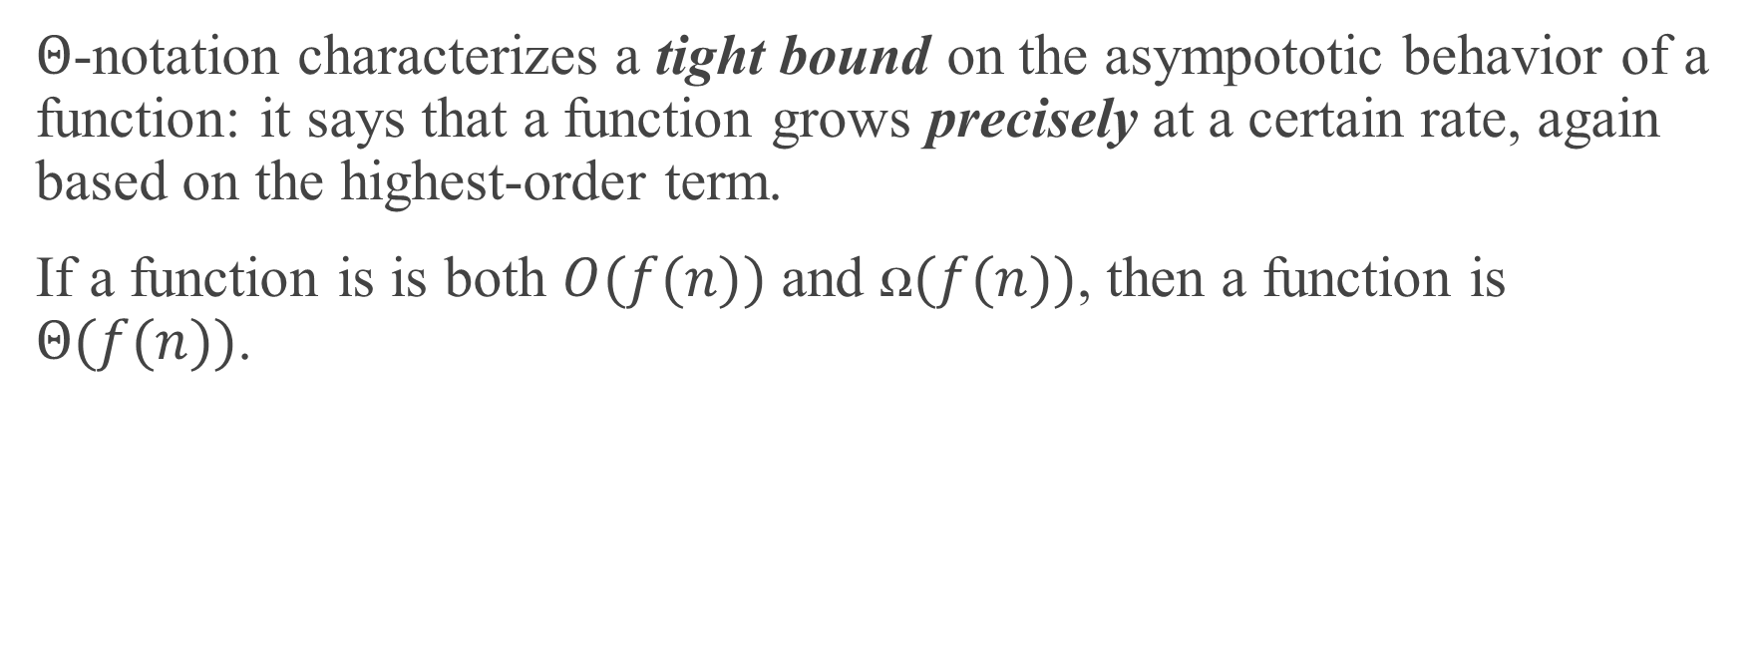
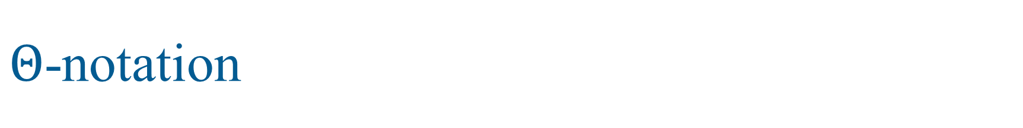
$Θ$-notation
$Θ$-notation characterizes a tight bound on the asympototic behavior of a function: it says that a function grows precisely at a certain rate, again based on the highest-order term.
If a function is is both $O(f(n))$ and $ꭥ(f(n))$, then a function is $Θ(f(n))$.

Slide 7
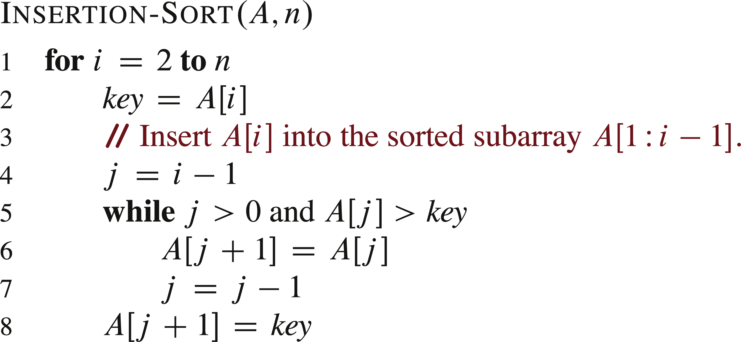
EXAMPLE: INSERTION-SORT

Slide 8
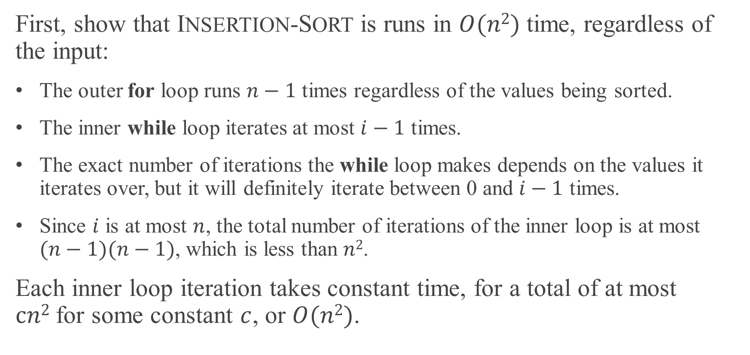
EXAMPLE: INSERTION-SORT (continued)
First, show that INSERTION-SORT is runs in $O(n2)$ time, regardless of the input:
The outer for loop runs $n−1$ times regardless of the values being sorted.
The inner while loop iterates at most $i−1$ times.
The exact number of iterations the while loop makes depends on the values it iterates over, but it will definitely iterate between 0 and $i−1$ times.
Since $i$ is at most $n$, the total number of iterations of the inner loop is at most $(n−1)(n−1)$, which is less than $n2$.
Each inner loop iteration takes constant time, for a total of at most $cn2$for some constant $c$, or $O(n2)$.

Slide 9
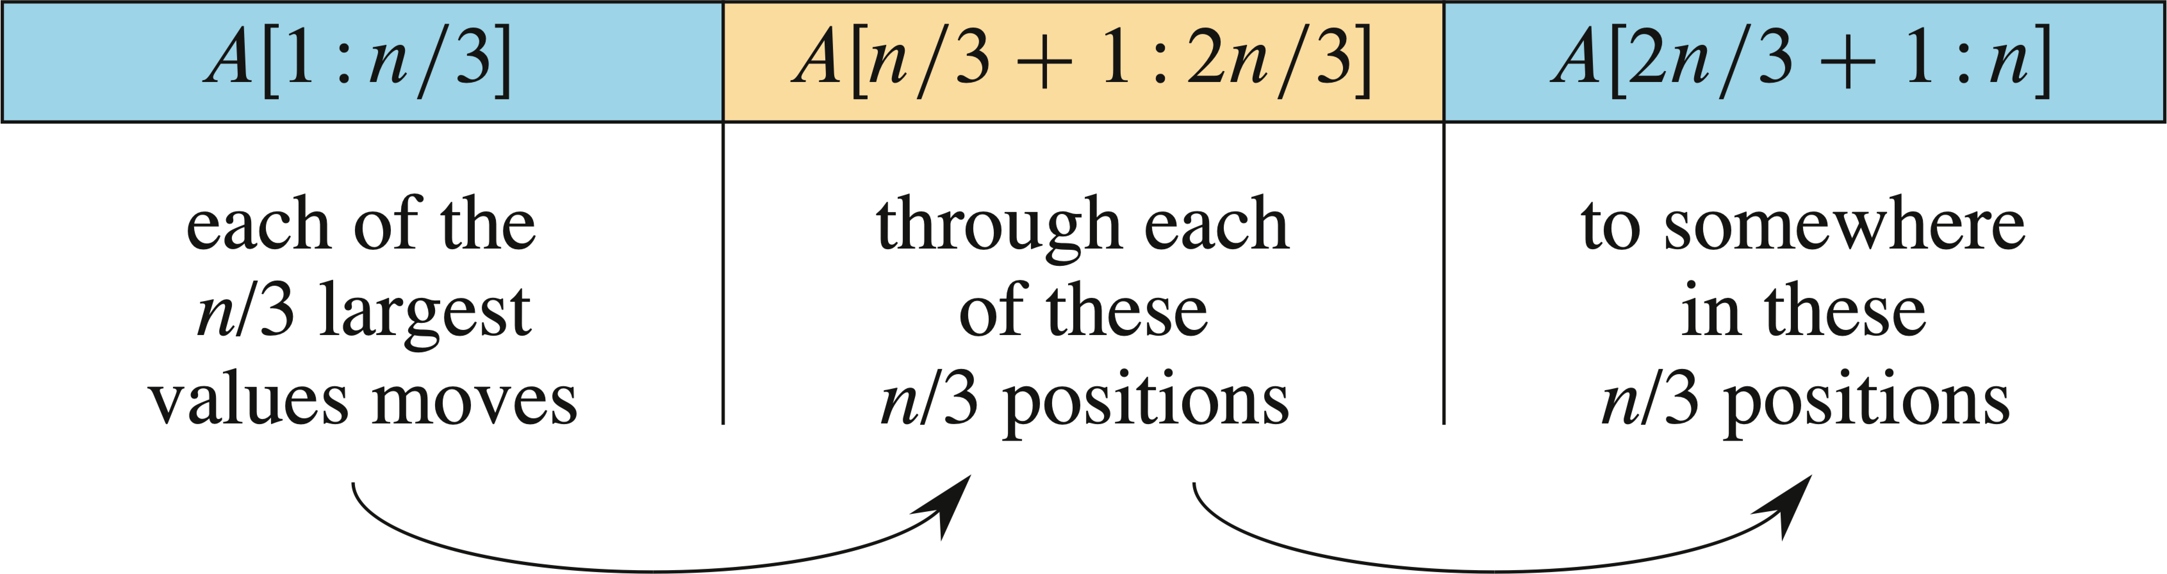

EXAMPLE: INSERTION-SORT (continued)
Now show that INSERTION-SORT has a worst-case running time of $ꭥ(n2)$:
Observe that for a value to end up $k$ positions to the right of where it started, the line $A[j+1]=A[j]$ must have been executed $k$ times.
Assume that $n$ is a multiple of 3 so that we can divide the array $A$ into groups of $n/3$ positions.

Slide 10
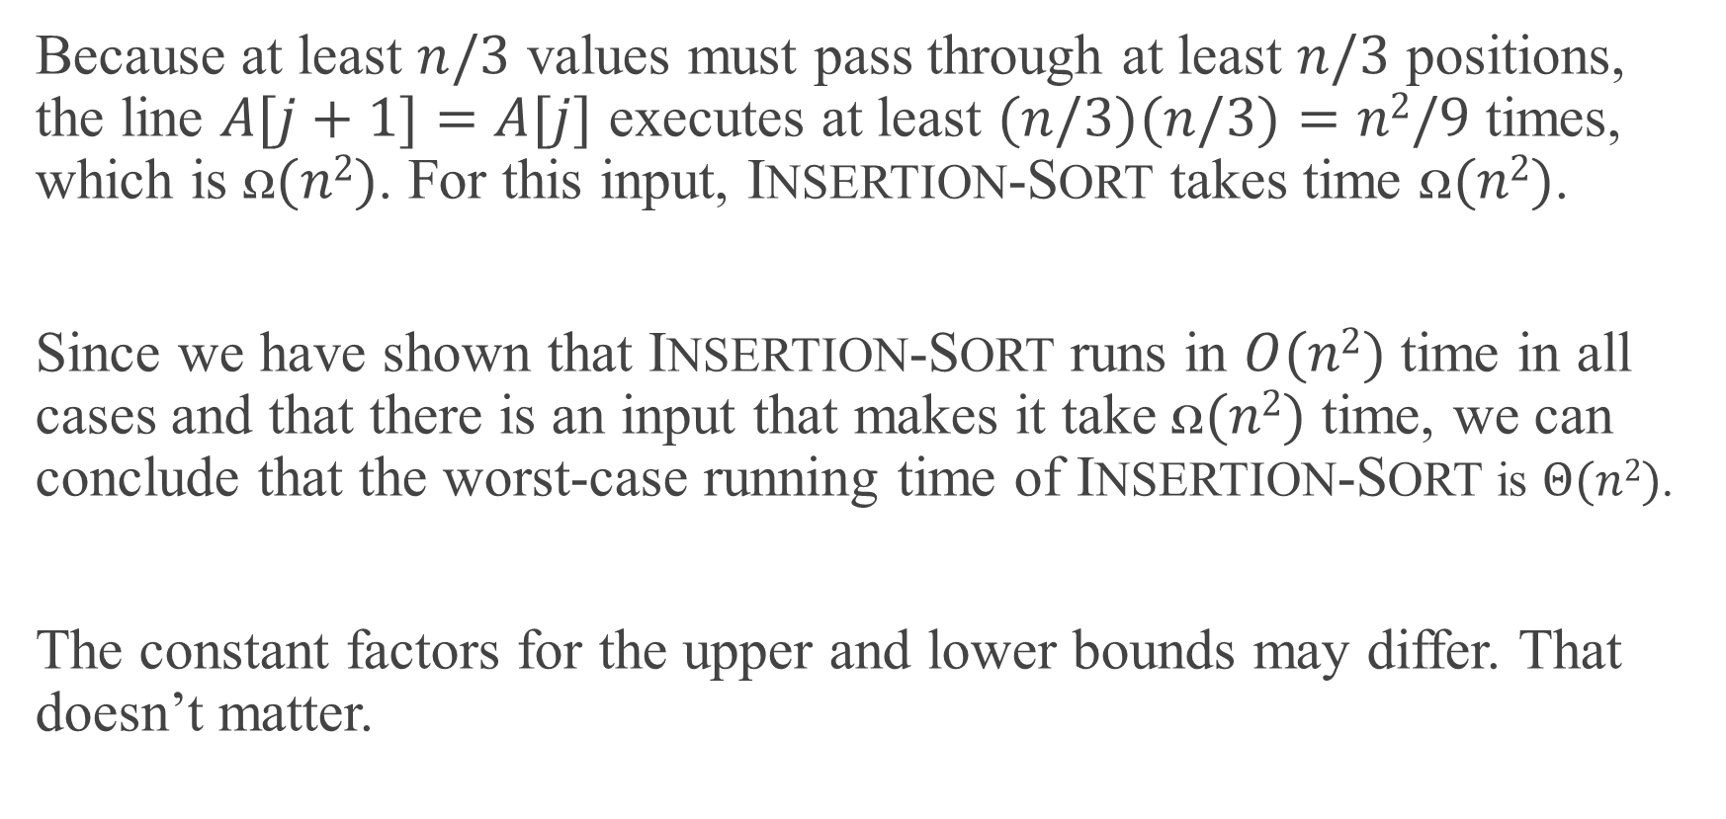
EXAMPLE: INSERTION-SORT (continued)
Because at least $n/3$ values must pass through at least $n/3$ positions, the line $A[j+1]=A[j]$ executes at least $(n/3)(n/3)=n2/9$ times, which is $ꭥ(n2)$. For this input, INSERTION-SORT takes time $ꭥ(n2)$.
Since we have shown that INSERTION-SORT runs in $O(n2)$ time in all cases and that there is an input that makes it take $ꭥ(n2)$ time, we can conclude that the worst-case running time of INSERTION-SORT is $Θ(n2)$.
The constant factors for the upper and lower bounds may differ. That doesn’t matter.

Slide 11
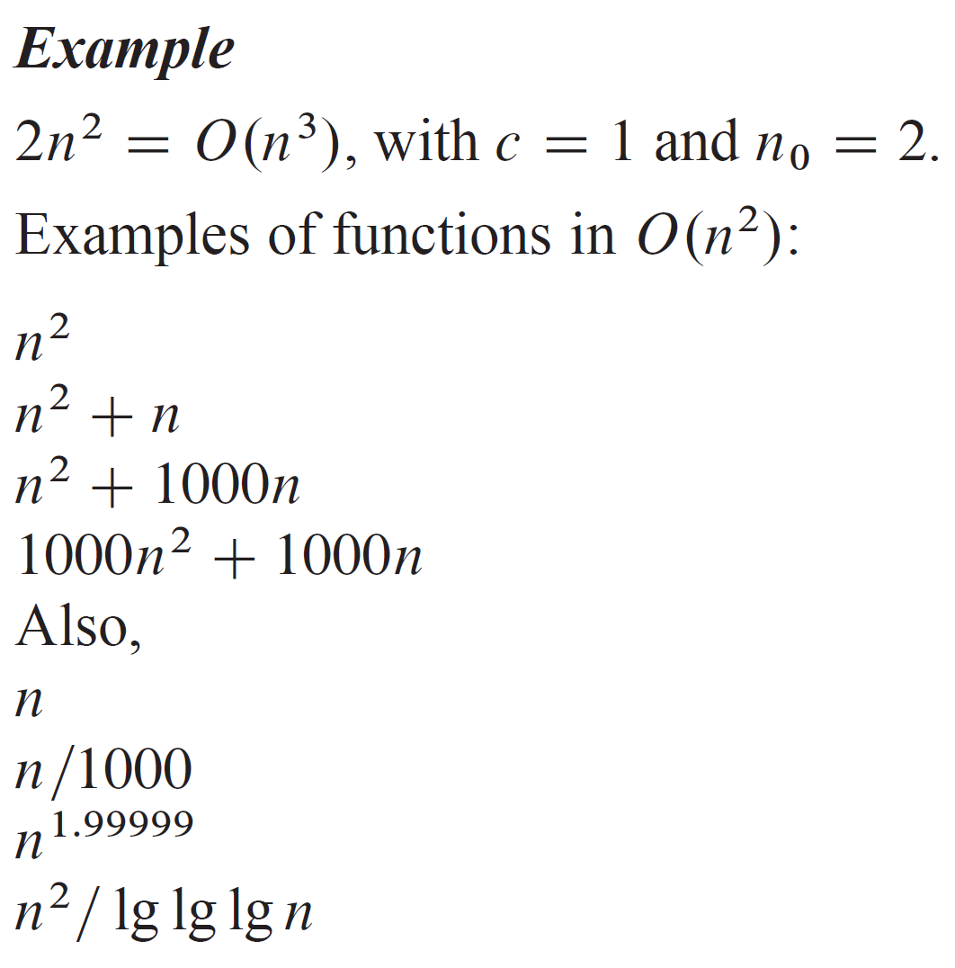
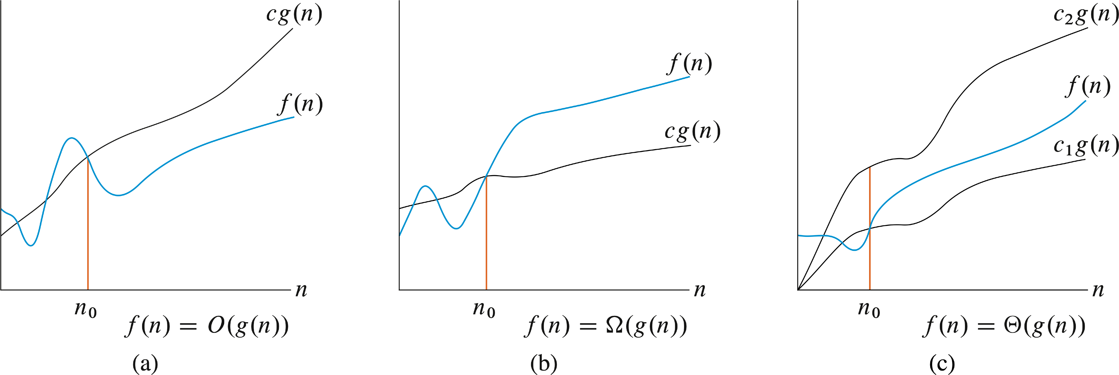
O-notation

Slide 12
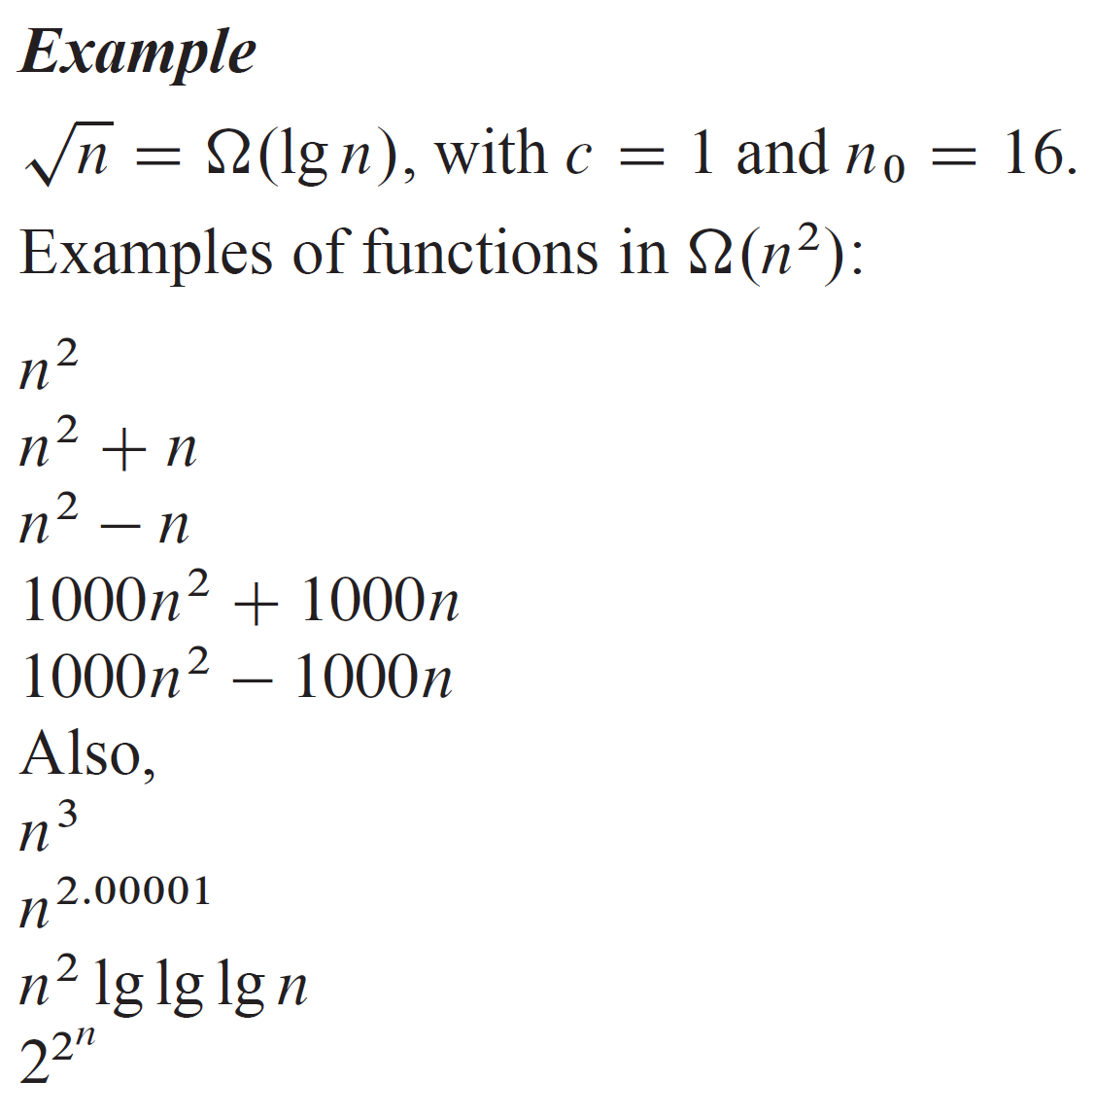
ꭥ-notation

Slide 13
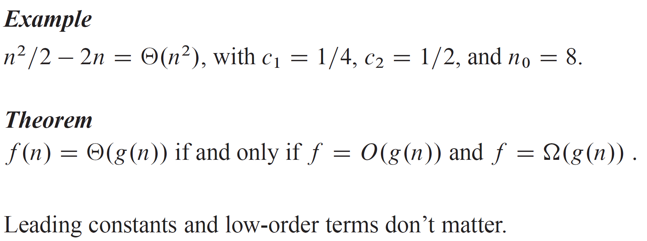
Θ-notation

Slide 14
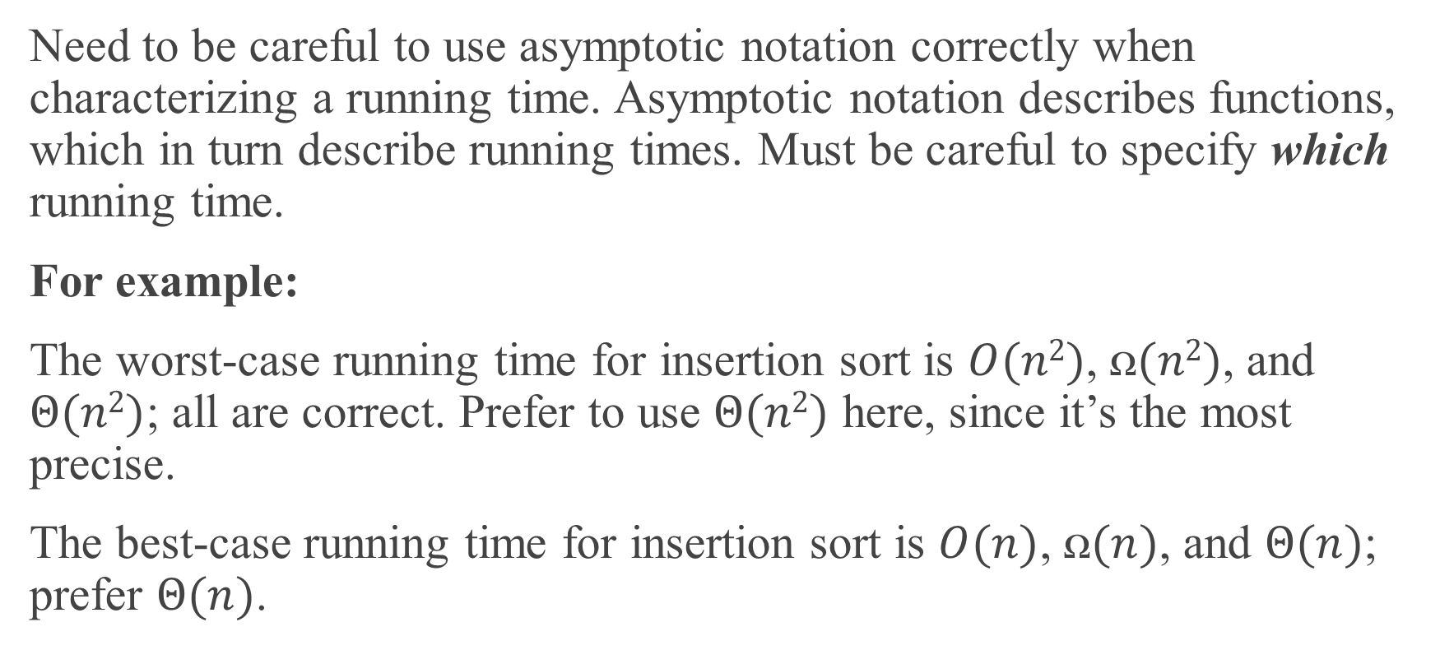
ASYMPTOTIC NOTATION AND RUNNING TIMES
Need to be careful to use asymptotic notation correctly when characterizing a running time. Asymptotic notation describes functions, which in turn describe running times. Must be careful to specify which running time.
For example:
The worst-case running time for insertion sort is $O(n2)$, $ꭥ(n2)$, and $Θ(n2)$; all are correct. Prefer to use $Θ(n2)$ here, since it’s the most precise.
The best-case running time for insertion sort is $O(n)$, $ꭥ(n)$, and $Θ(n)$; prefer $Θ(n)$.

Slide 15
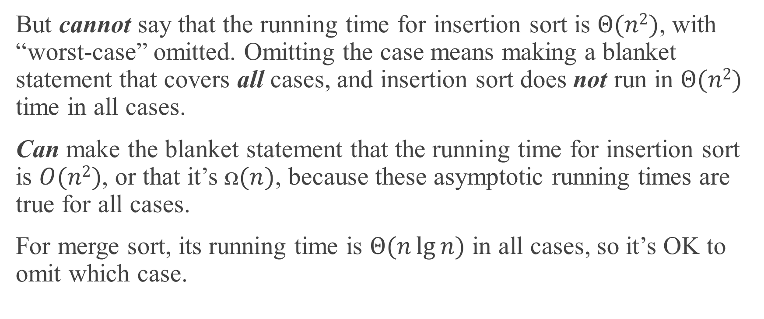
ASYMPTOTIC NOTATION AND RUNNING TIMES (continued)
But cannot say that the running time for insertion sort is $Θ(n2)$, with “worst-case” omitted. Omitting the case means making a blanket statement that covers all cases, and insertion sort does not run in $Θ(n2)$ time in all cases.
Can make the blanket statement that the running time for insertion sort is $O(n2)$, or that it’s $ꭥ(n)$, because these asymptotic running times are true for all cases.
For merge sort, its running time is $Θ(n\lg{n})$ in all cases, so it’s OK to omit which case.

Slide 16
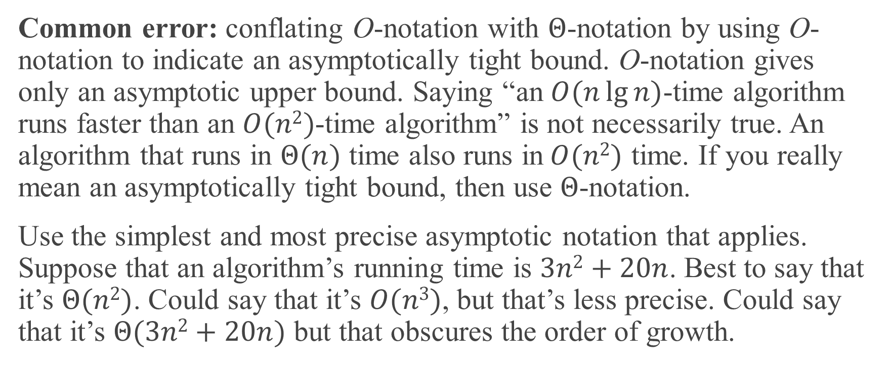
ASYMPTOTIC NOTATION AND RUNNING TIMES (continued)
Common error: conflating O-notation with $Θ$-notation by using O-notation to indicate an asymptotically tight bound. O-notation gives only an asymptotic upper bound. Saying “an $O(n\lg{n)}$-time algorithm runs faster than an $O(n2)$-time algorithm” is not necessarily true. An algorithm that runs in $Θ(n)$ time also runs in$O(n2)$ time. If you really mean an asymptotically tight bound, then use $Θ$-notation.
Use the simplest and most precise asymptotic notation that applies. Suppose that an algorithm’s running time is $3n2+20n$. Best to say that it’s $Θ(n2)$. Could say that it’s $O(n3)$, but that’s less precise. Could say that it’s $Θ(3n2+20n)$ but that obscures the order of growth.

Slide 17
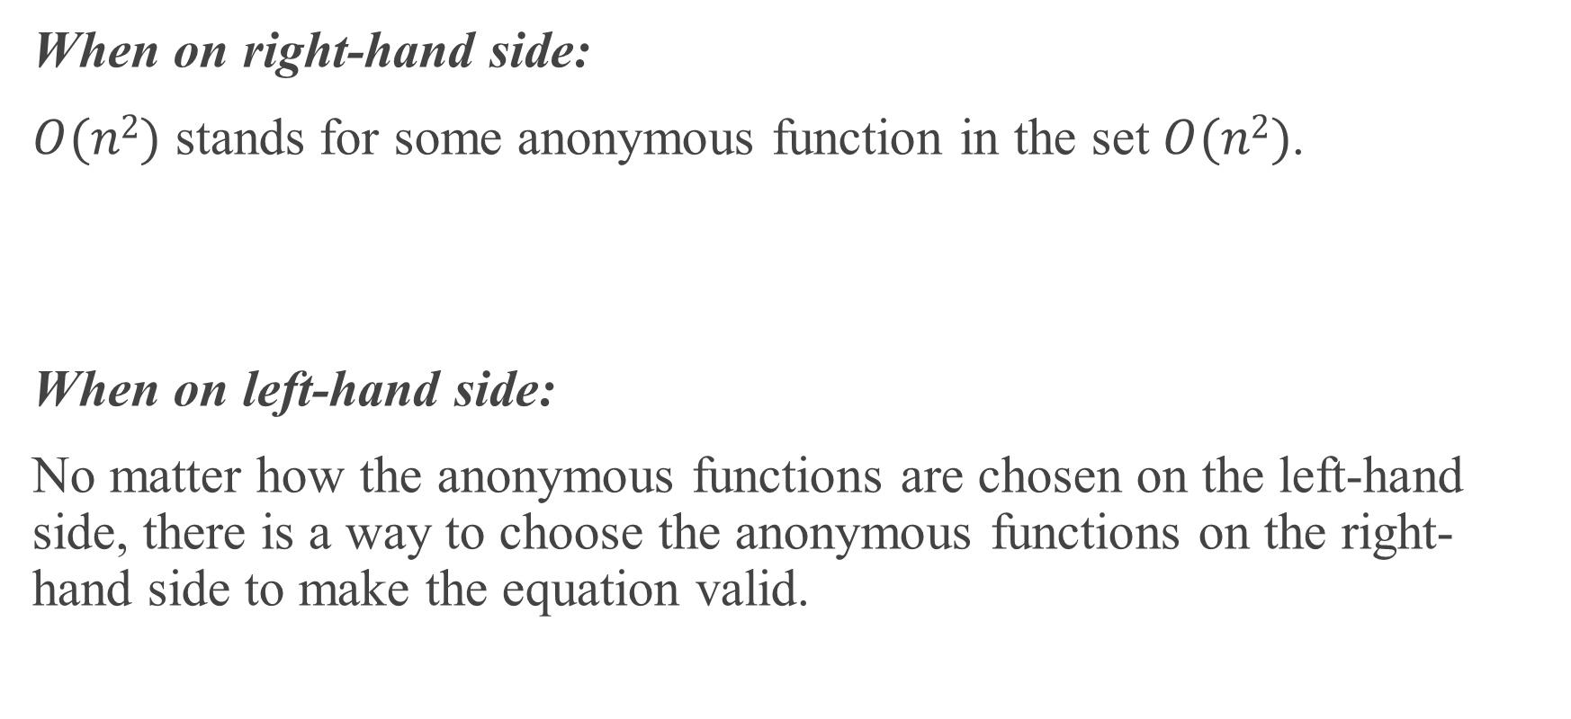
ASMPTOTIC NOTATION IN EQUATIONS
When on right-hand side:
$O(n2)$ stands for some anonymous function in the set $O(n2)$.
When on left-hand side:
No matter how the anonymous functions are chosen on the left-hand side, there is a way to choose the anonymous functions on the right-hand side to make the equation valid.

Slide 18
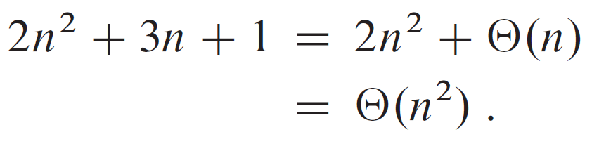
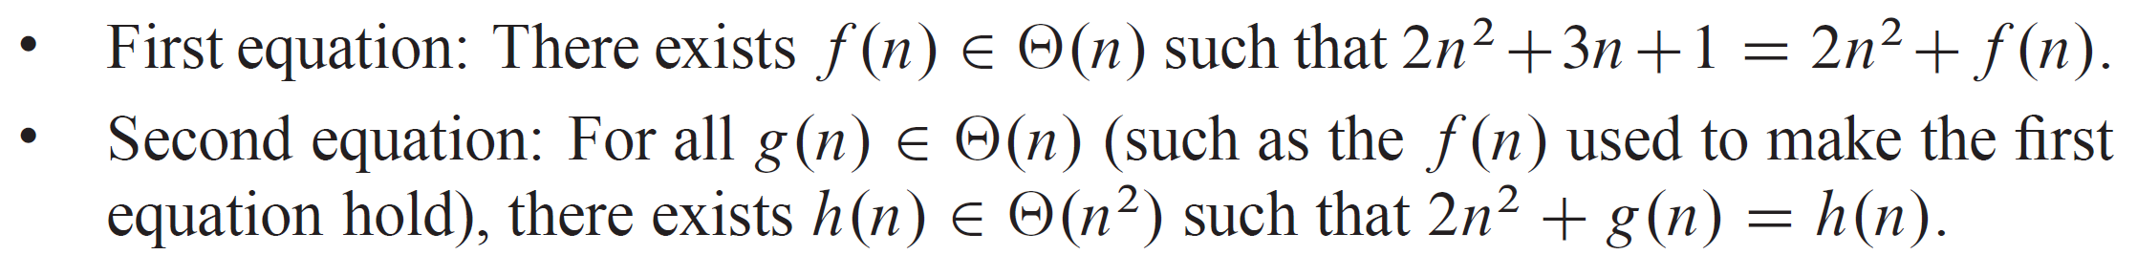
ASMPTOTIC NOTATION IN EQUATIONS (continued)
Can chain together:
Interpretation:

Slide 19
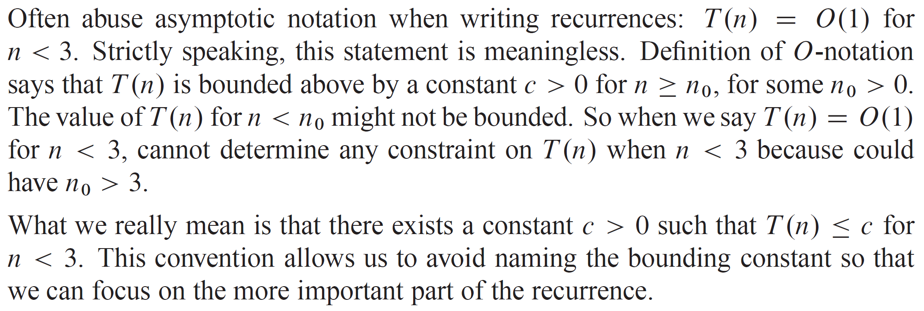
SUBTLE POINT: ASYMPTOTIC NOTATION IN RECURRENCES

Slide 20
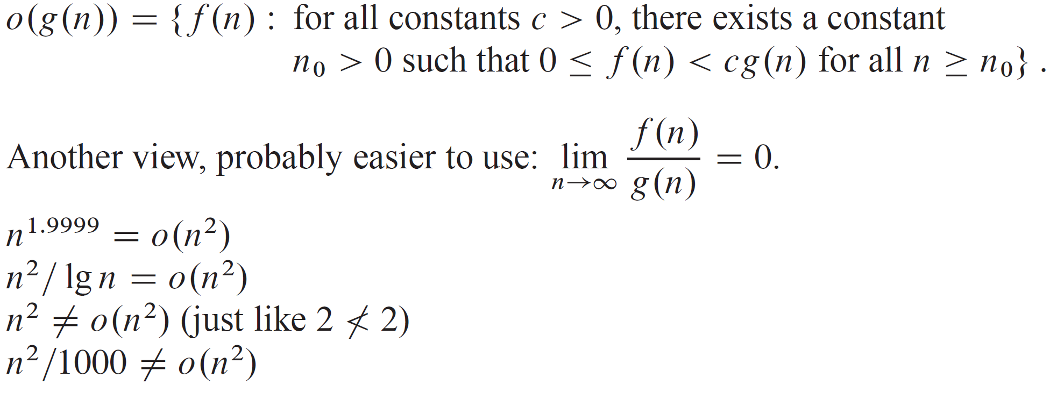
O-notation

Slide 21
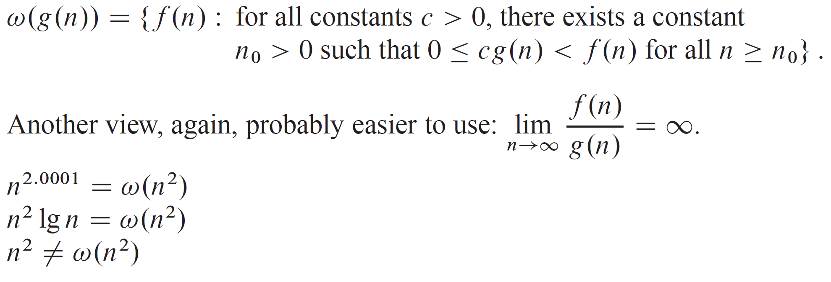
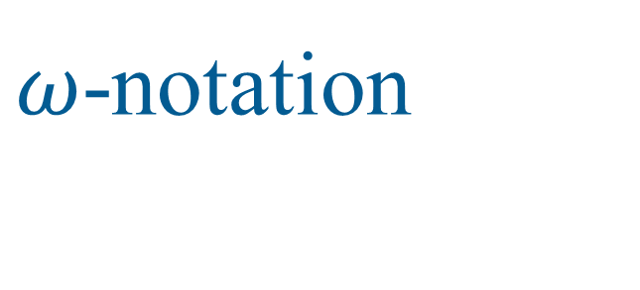
$ω$-notation

Slide 22
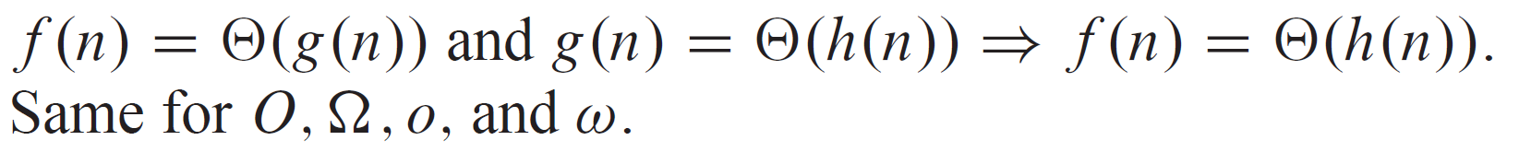
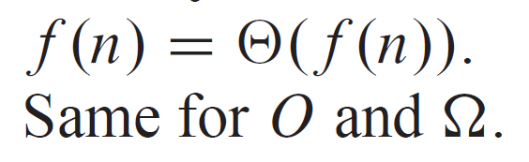
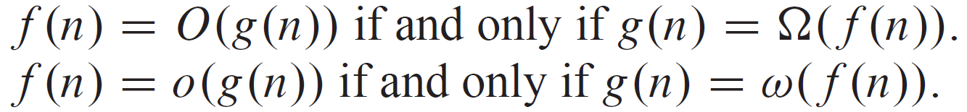
COMPARISONS OF FUNCTIONS
Transitivity:
Reflexivity:
Symmetry:
Transpose symmetry:

Slide 23
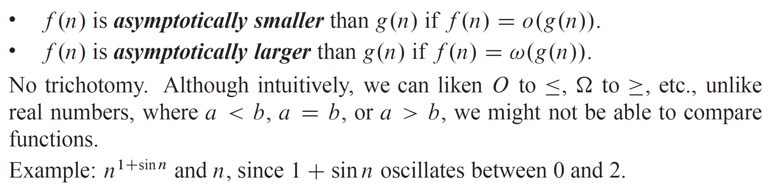
COMPARISONS OF FUNCTIONS (continued)
Comparisons:

Slide 24
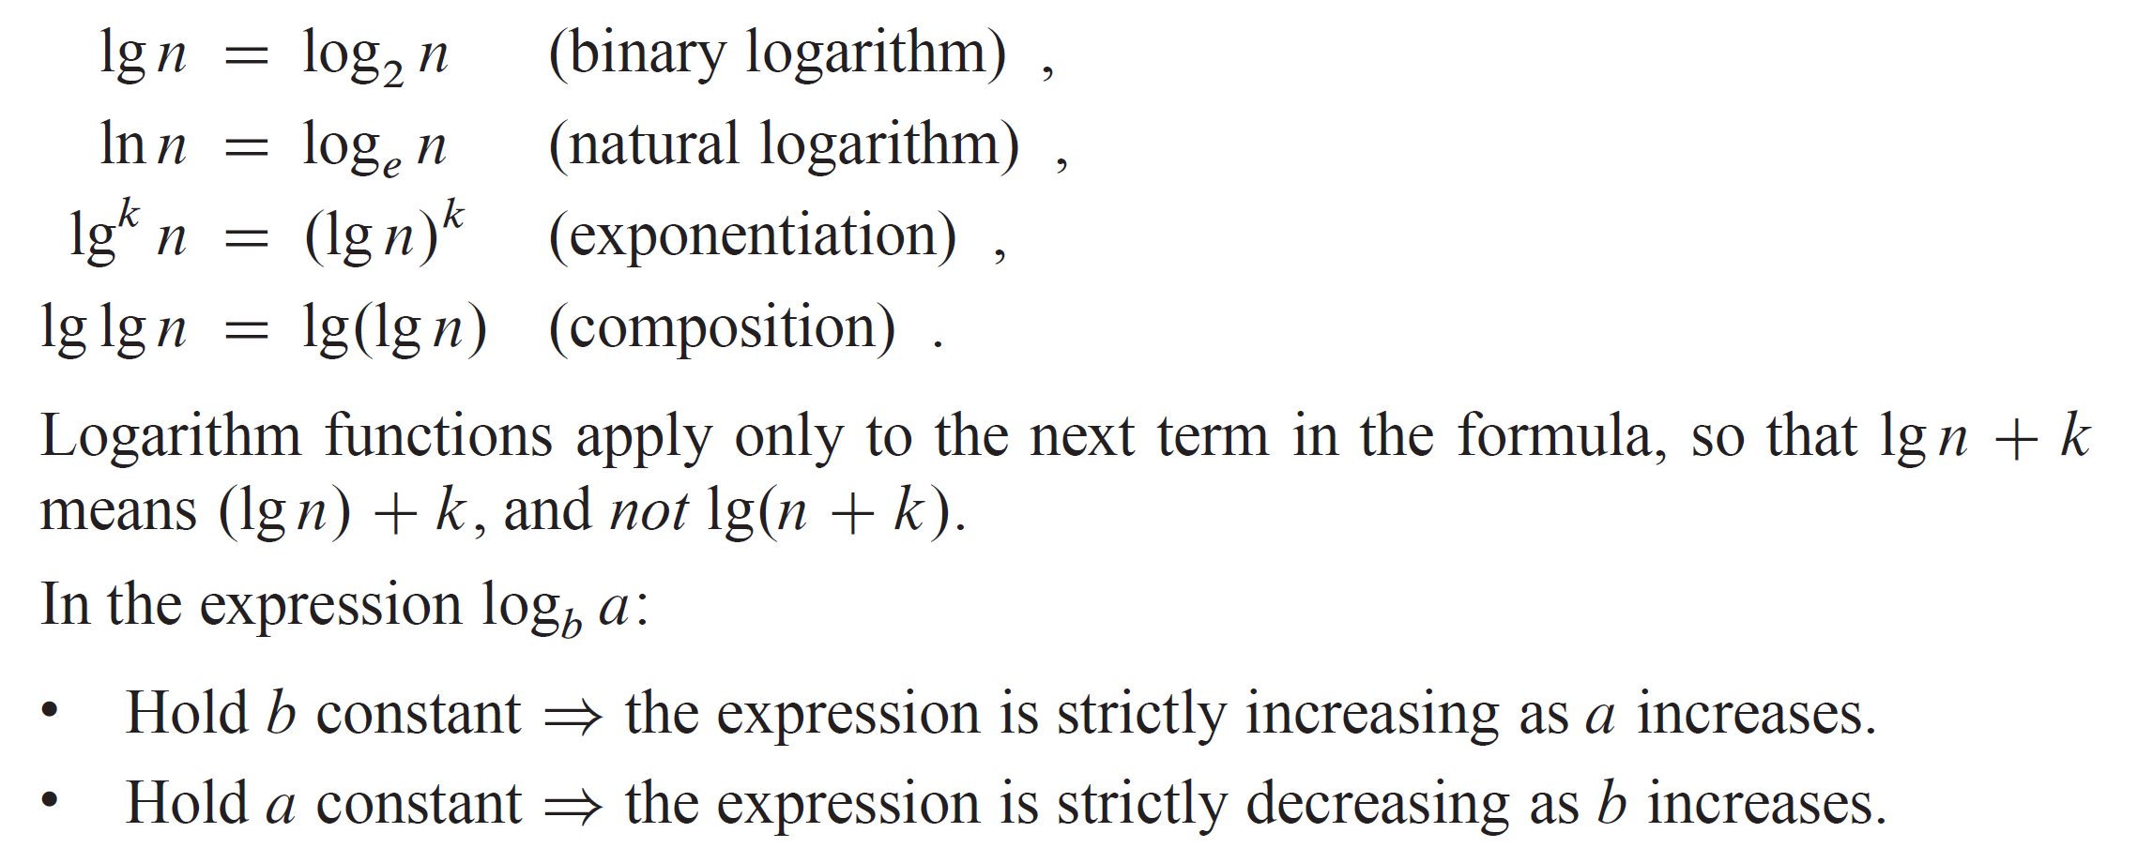
LOGARITHMS
Notations:

Slide 25
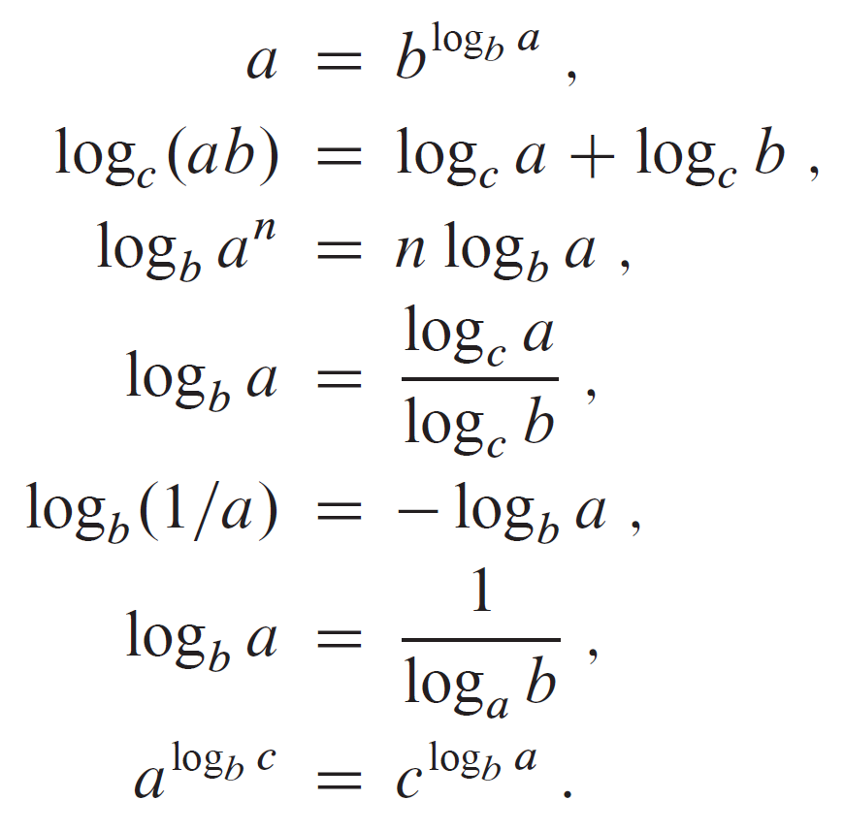
LOGARITHMS (continued)

